Slide 1
MA2012 Introduction to Mechatronics Systems Design (Circuit 2)
A/P Ang Wei Tech
Email: wtang@ntu.edu.sg
Tel: 6790 4911
Office: N3-01-04

Slide 2
Components
Circuit 2A:
Servomotor
Stepper motor
DC motor
DC motor + Encoder
Circuit 2B:
16-key Hexadecimal Keypad
74C922 Keypad Encoder
Liquid Crystal Display (LCD)

Slide 3
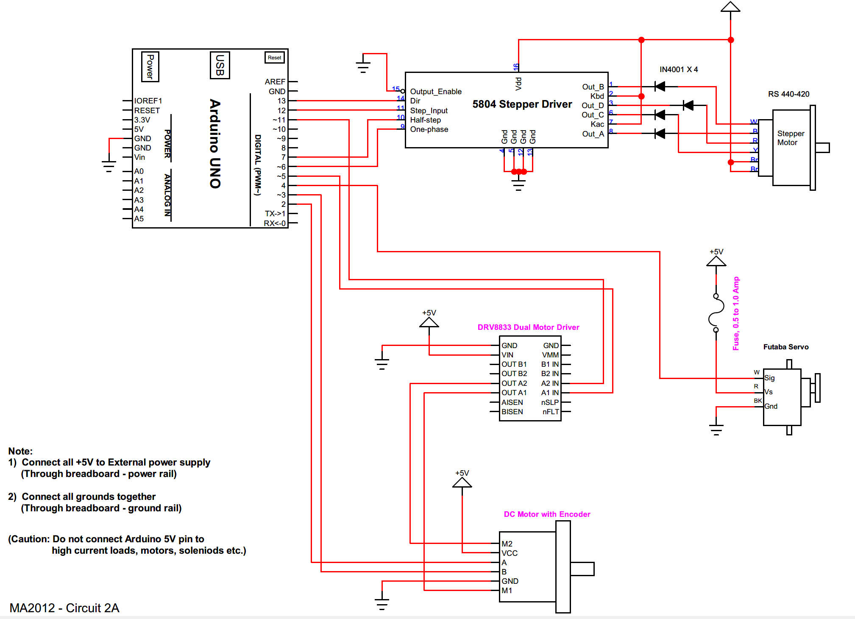
Circuit 2A

Slide 4
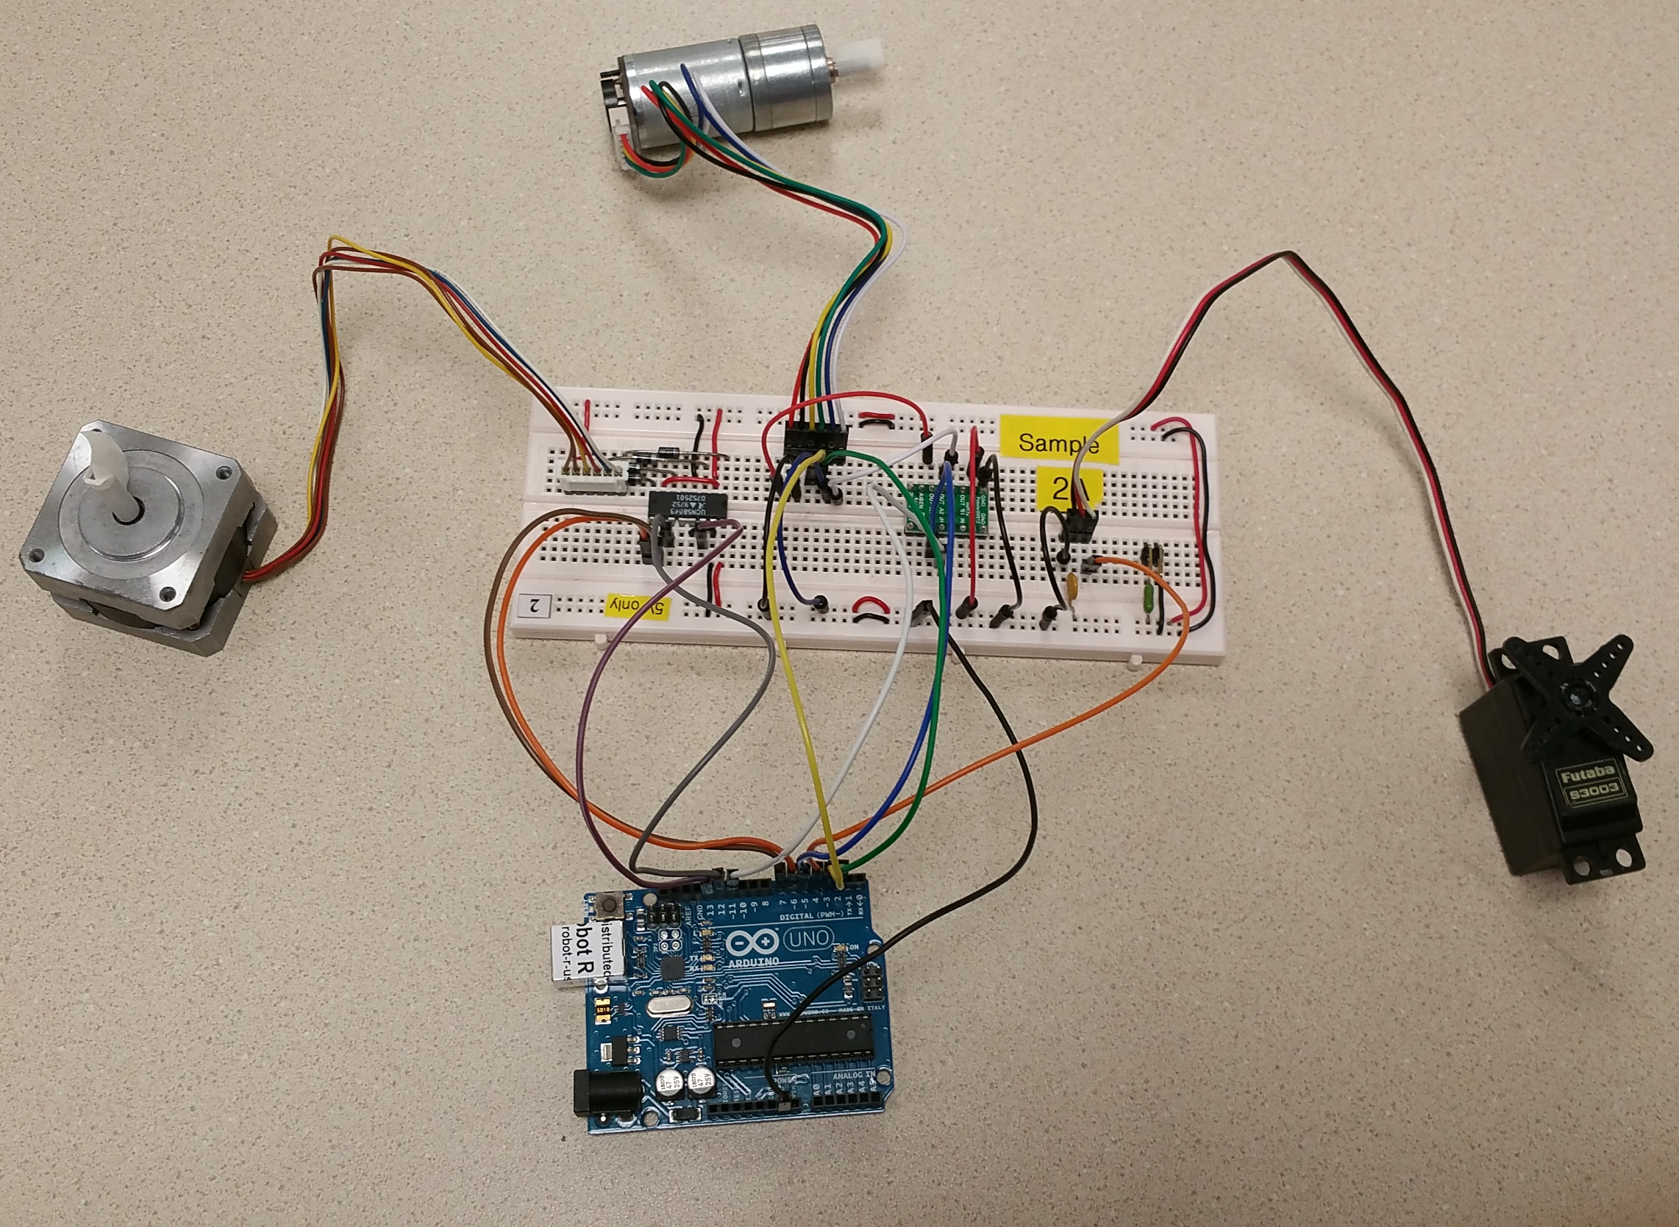
Circuit 2A

Slide 5
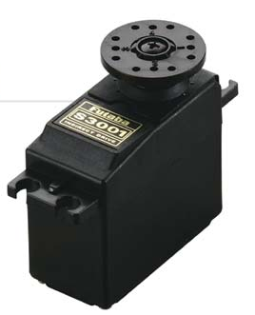

Servo Motor
The drive flange can rotate ½ revolution
It is driven by high pulse (Logic 1) called ‘Mark’
0° to 180°
(-90° to +90°)
Mark
Space

Slide 6
Servo Motor
Drive flange rotation (°)
180
135
Safe range
90
45
Mark Length (ms)
0
0.5
1.0
1.5
2.0
2.5

Slide 7
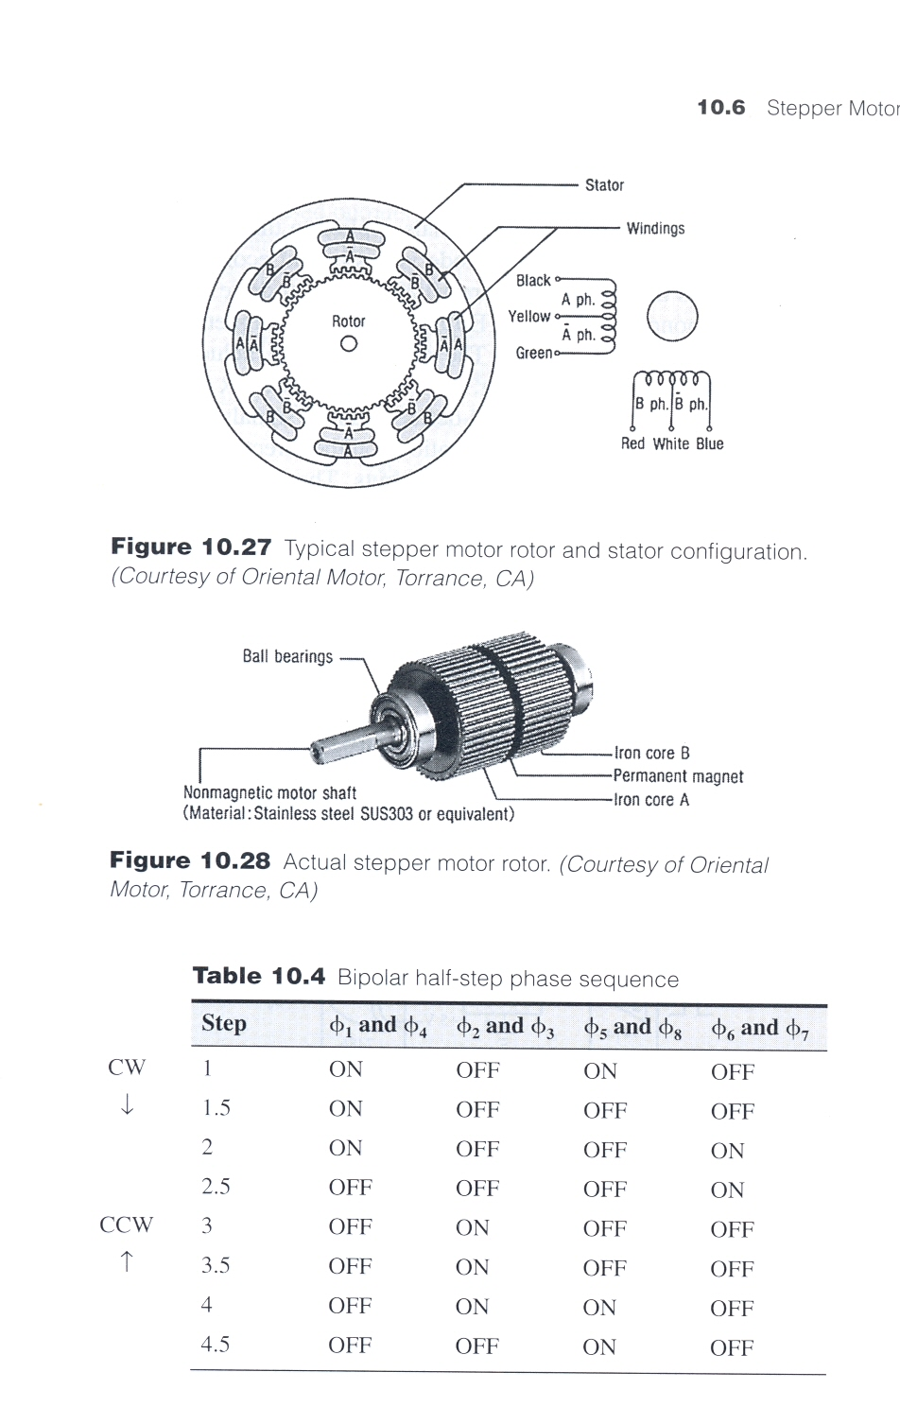
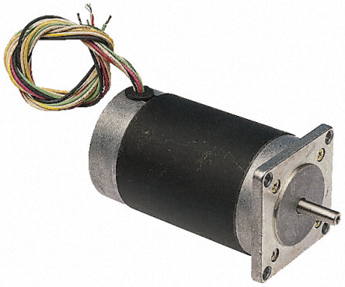
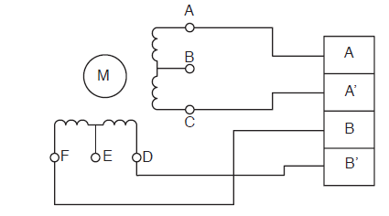
Stepper Motor
Stator
Windings
RS 440-420
Rotor & Stator Configuration
White
Brown
Red
Blue
Yellow
Brown
Stepper Motor Construction

Slide 8
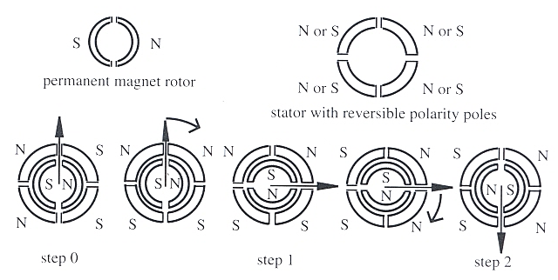
Stepper Motor Working Principle

Slide 9
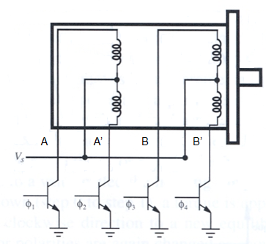
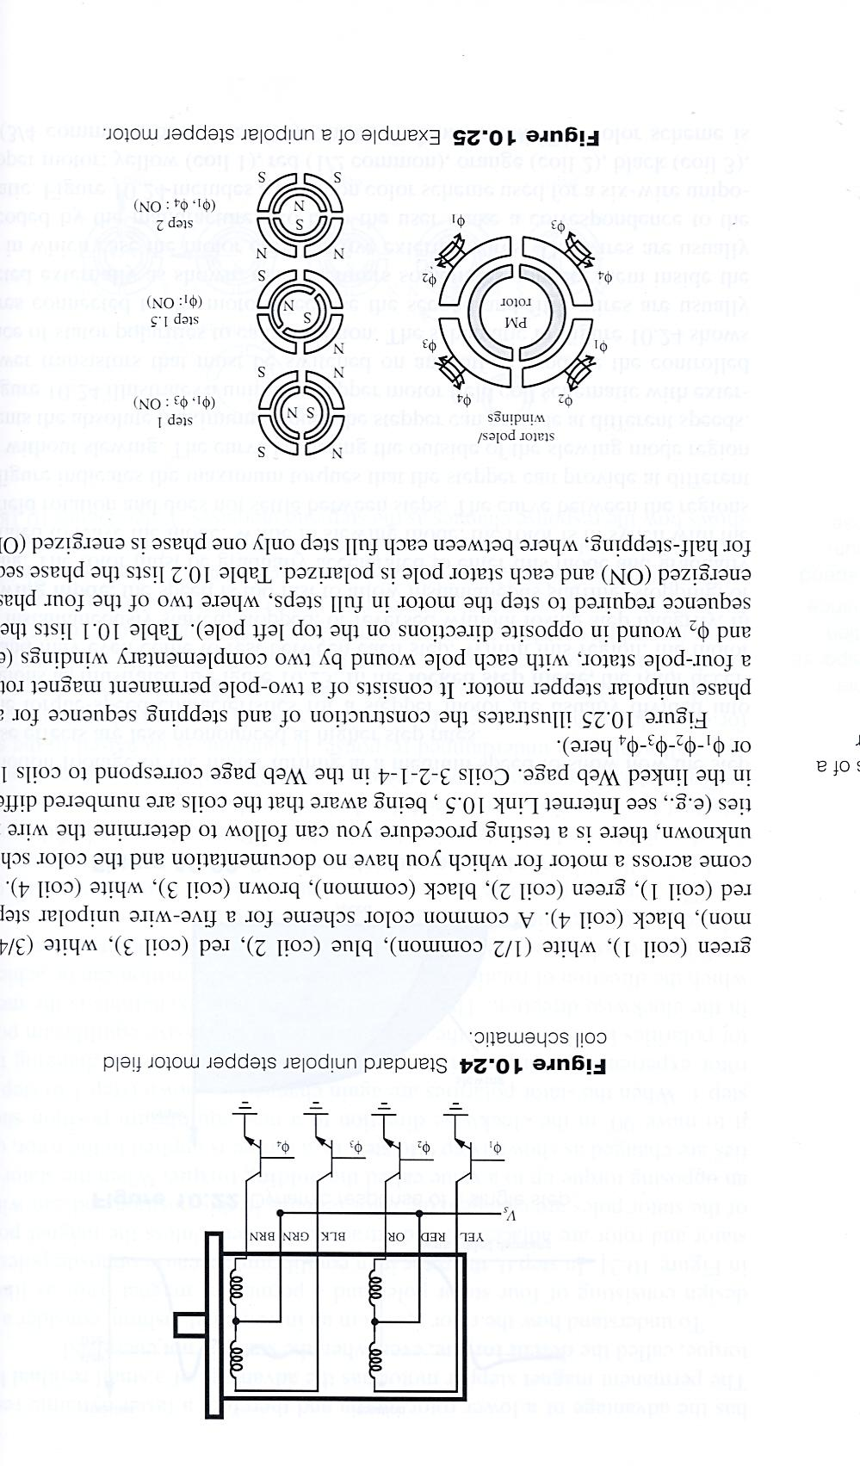
Stepping Sequence (Wave-Drive / Single Phase)
Step | A (φ₁) | B (φ₃) | A’ (φ₂) | B’ (φ₄)
1 | On
2 |  | On
3 |  |  | On
4 |  |  |  | On
Unipolar stepper motor
Step 1, 2, 3, 4, 1 … : CCW
Step 1, 4, 3, 2, 1 … : CW
Step 1

Slide 10
Stepping Sequence (2 Phase Full Step)
Step | A (φ₁) | B (φ₃) | A’ (φ₂) | B’ (φ₄)
1 | On | On
2 |  | On | On
3 |  |  | On | On
4 | On |  |  | On
Unipolar stepper motor
Step 1, 2, 3, 4, 1 … : CCW
Step 1, 4, 3, 2, 1 … : CW
Step 1

Slide 11
Stepping Sequence (2 Phase Half Step)
Step | A (φ₁) | B (φ₃) | A’ (φ₂) | B’ (φ₄)
1 | On | On
1.5 |  | On
2 |  | On | On
2.5 |  |  | On
3 |  |  | On | On
3.5 |  |  |  | On
4 | On |  |  | On
4.5 | On
4.5
Step 1, 1.5, 2, 2.5, 3, 3.5, 4, 4.5, 1 … : CCW
Step 1, 4.5, 4, 3.5, 3, 2.5, 2, 1.5, 1 … : CW
4

Slide 12
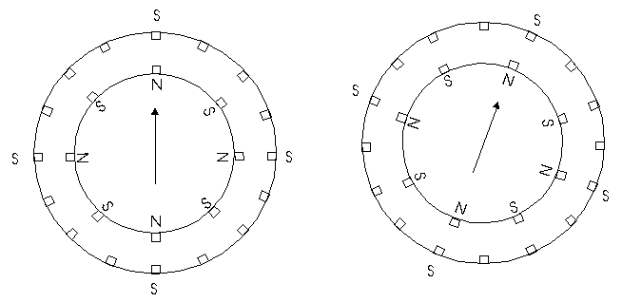
Step Sequence – Higher Resolution
Double the number of poles will half the step size

Slide 13
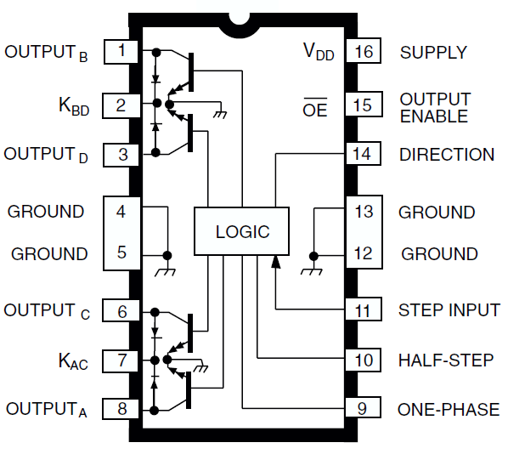
Stepper Driver UCN5804B
Three types of drive:
Wave drive (A-B-C-D)
Two phase full step (AB-BC-CD-DA)
Two phase half step (A-AB-B-BC-C-CD-D-DA)
See data sheet for more details

Slide 14
Motion Control Fundamental
Power = VI = τω
DC motor control
Voltage controls velocity: V ∝ ω
Current controls torque: I ∝ τ
Rated power
Motor running at rated speed, drawing rated current
Motor reliably, performance, etc. is guaranteed by manufacturer

Slide 15
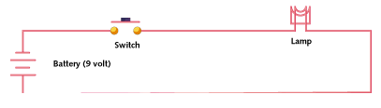
Pulse Width Modulation
If switch is always on, lamp receives 9V and light up to the rated brightness
If switch is 50% on and 50% off very quickly (1 – 200 kHz), lamp receives an equivalent of 4.5 V, thus only 50% of rated brightness

Slide 16
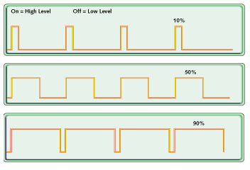
Pulse Width Modulation
Duty cycle = % of on = % of rated power (assuming constant current)
Digital-to-Analog Converter (DAC) is expensive
Not many MCU are equipped with a DAC
Solution: PWM

Slide 17
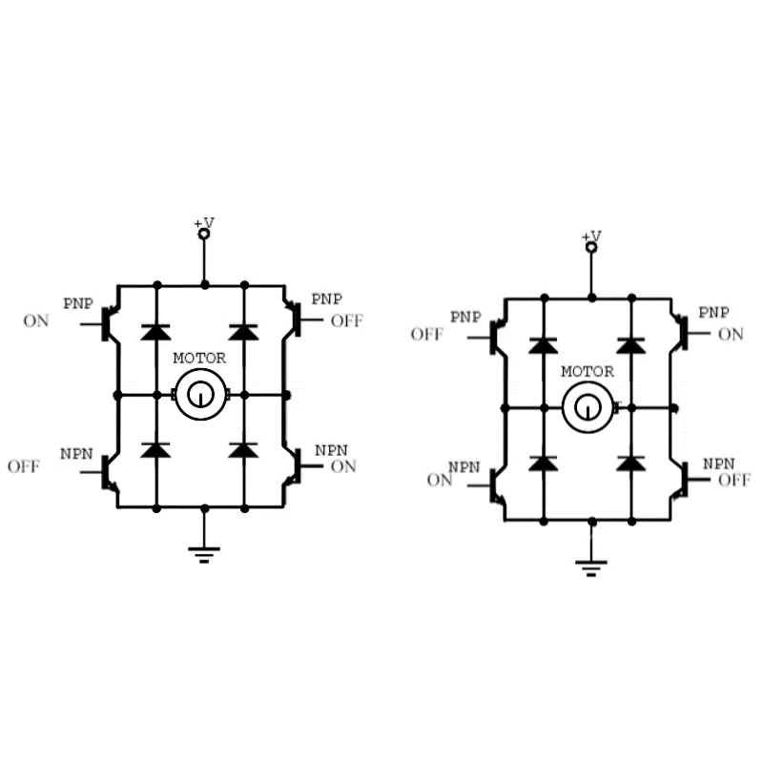
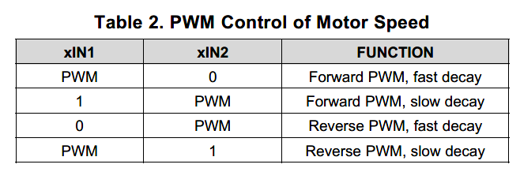
DC Motor Control with H-Bridge
Clockwise rotation
Counterclockwise rotation
See datasheet DRV8833
Slow deceleration
Fast deceleration

Slide 18
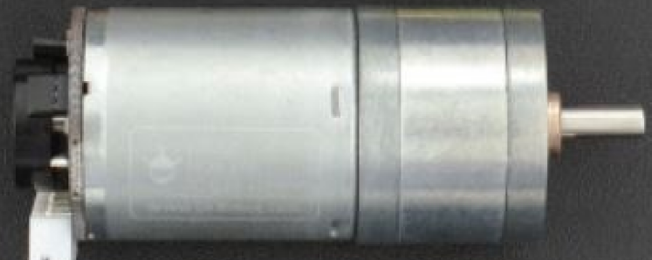
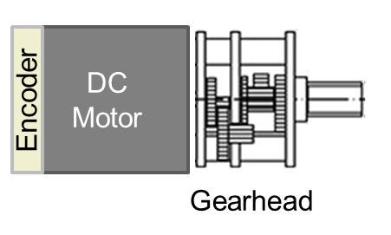

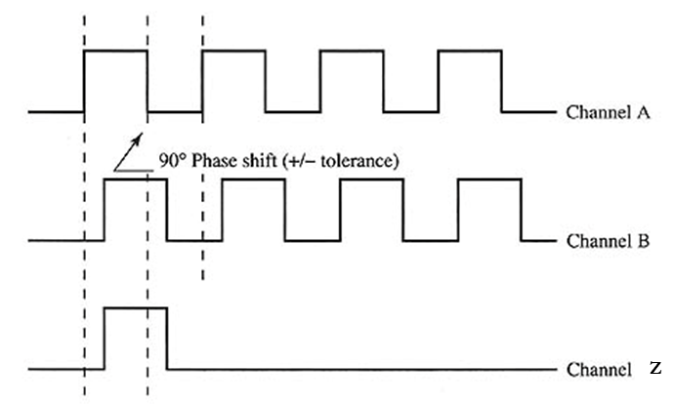
Geared Motor with Encoder
Encoder Resolution: Hall Resolution 11x Speed Reduction Ratio 34 = 374 PPR (pulse per revolution)
What is the encoder resolution in degree per pulse?
Incremental (Quadrature) encoder working principle:
ChA leads ChB by 90°: CCW
ChA lags ChB by 90°: CW
+ve
-ve
Rotation
- -
++
Encoder

Slide 19
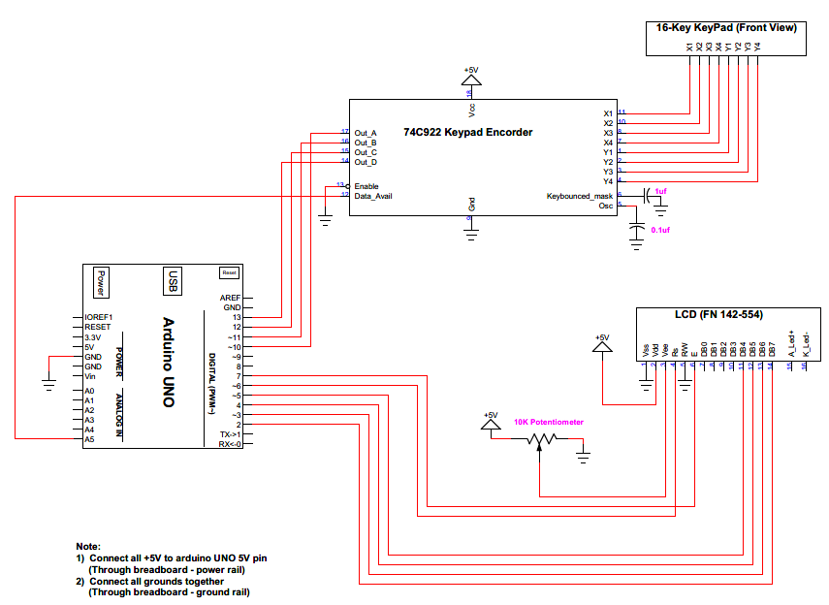
Circuit 2B

Slide 20
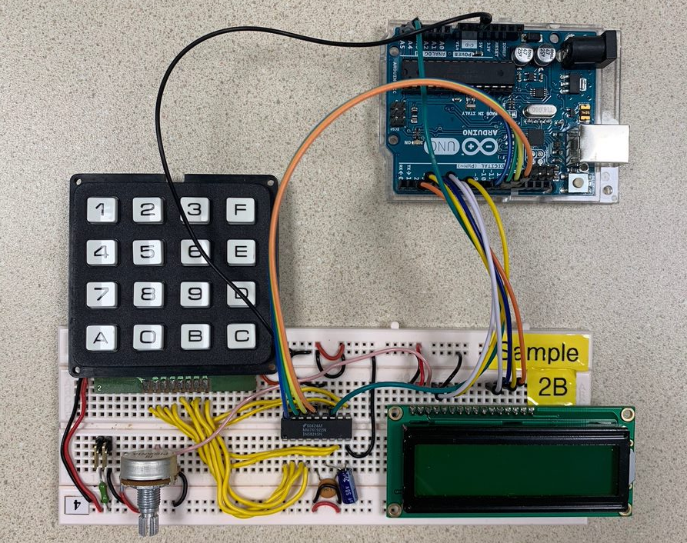
Circuit 2B

Slide 21
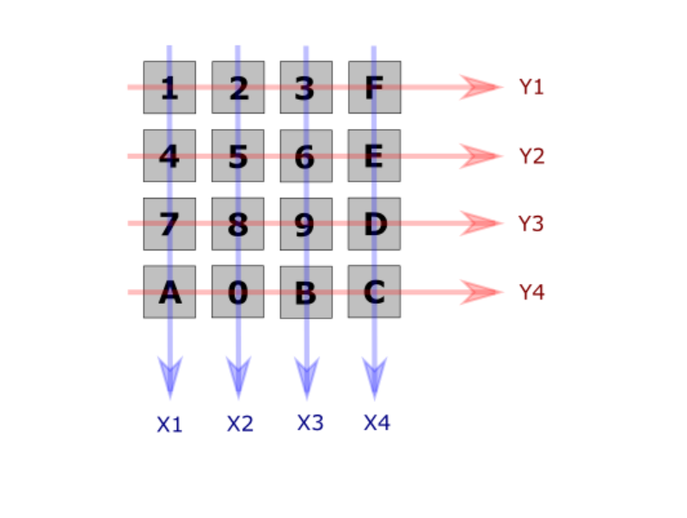
16-Key Hexadecimal Keypad
8 outputs

Slide 22
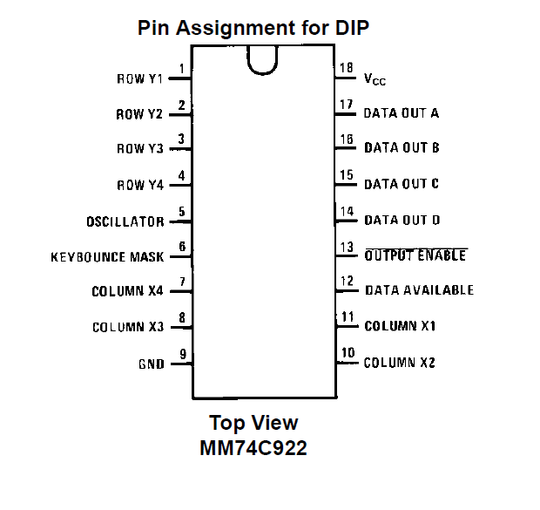
74C922 Keypad Encoder
8 inputs for Keypad
4 outputs
Data Available – Key entry

Slide 23
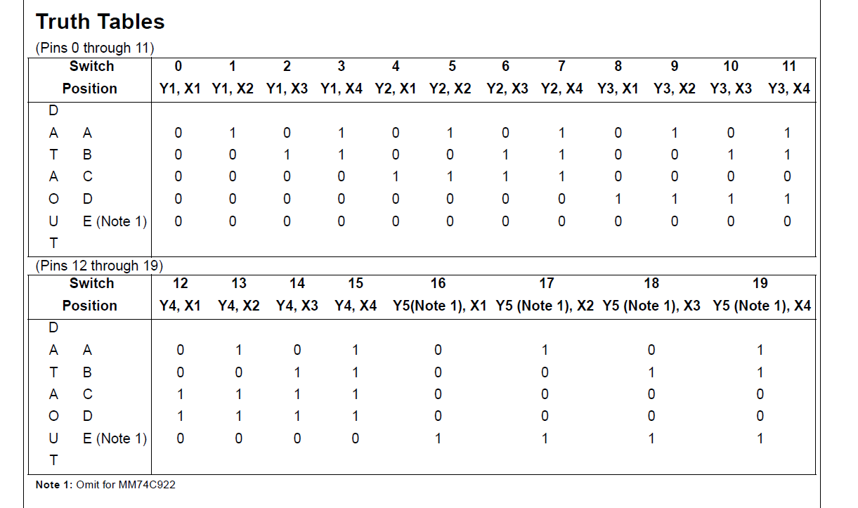
74C922 Keypad Encoder
Position = A + 2.B + 4.C + 8.D

Slide 24
Keypad Example
Read a keypad and print out the key to serial monitor
if(digitalRead(KB_DataAvailable))
k=ka+kb*2+kc*4+kd*8;
char keys[] = {'1','2','3','F',
'4','5','6','E',
'7','8','9','D',
'A','0','B','C'};

Slide 25
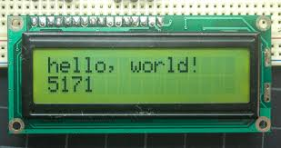
Liquid Crystal Display (LCD)
16 x 2 Character Module
See <LiquidCrystal.h> library

Slide 26
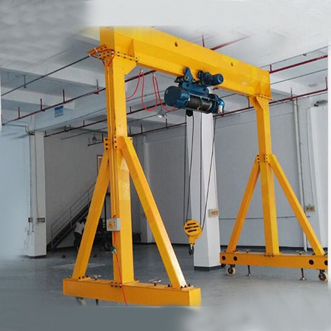
Exercise 2-1: Gantry Crane
Write a program to perform the follow tasks:
An operator uses the potentiometer to control the servomotor which positions the hoist of a Gantry Crane over an object placed around the mid point across the width of the crane (i.e. servomotor position between 80-100 deg).
When the hoist is in position, activating the pushbutton shall rotate the DC motor to raise/lower the cable to grab the object. Releasing the pushbutton shall stop the DC motor.
A toggle switch is used to control the direction of the cable:
HIGH = raising; LOW = lowering.
The pushbutton shall not activate the DC
motor if the servomotor is not in position
(outside 80-100 deg)

Slide 27
Exercise 2-2: Gantry Crane 2
With reference to Ex.2-1
Replace the Servomotor with a DC Motor with encoder.
Replace the DC motor with a Stepper Motor.

Slide 28
Exercise 2-3: Calculator
Write a program to perform the following tasks:
Pressing 2 consecutive keys of ‘F’ turn the keypad into a calculator:
‘A’ ≡ + (add), ‘B’ ≡ - (subtract), ‘C’ ≡ * (multiply), D ≡ / (divide), E ≡ = (equal)
The calculator should perform 3-digit (0-999) integer arithmetic, i.e. no decimal digits, e.g. 1.5 → 1.0
The LCD should display digits and/or symbols consistent with a normal calculator. You may apply appropriate assumptions.
Pressing keystrokes of ‘F’ + ‘E’ turn off the calculator function and return to displaying entered keys

